Slide 1

SPRINT B report
LAPR4, 22/23

Slide 2
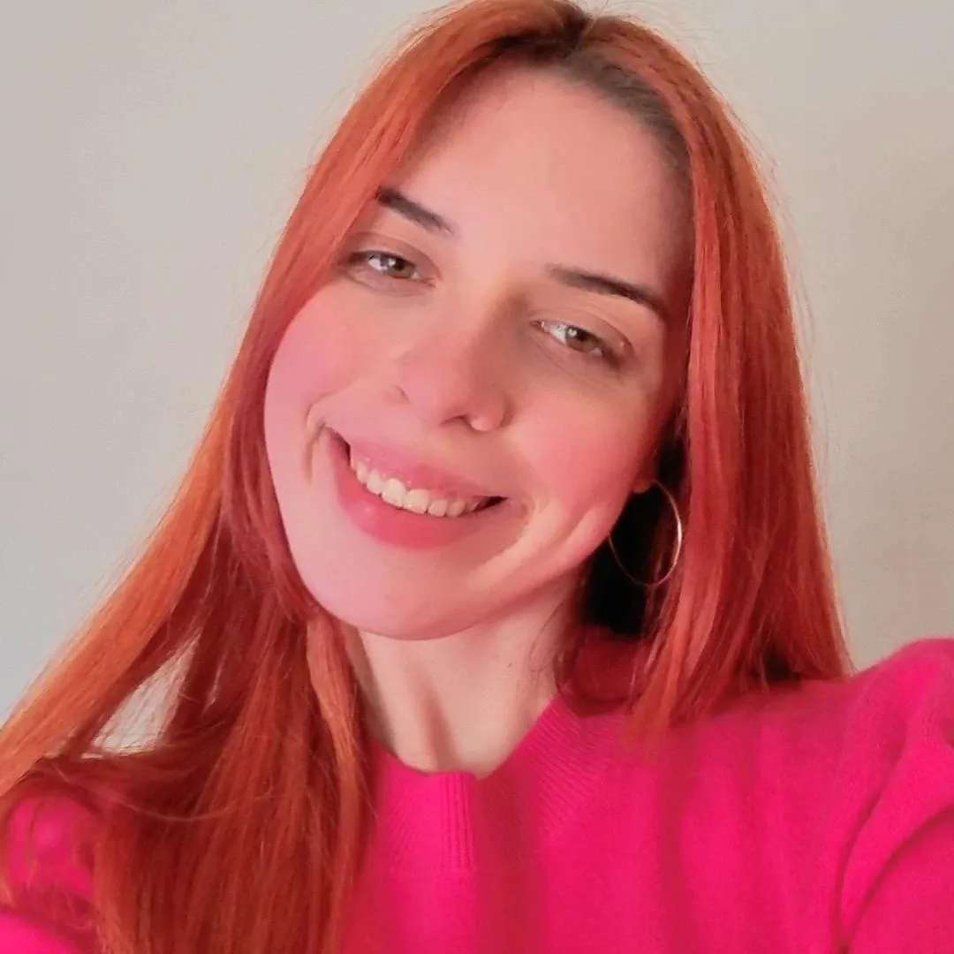
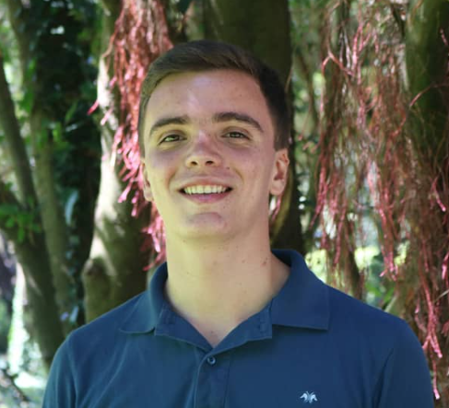
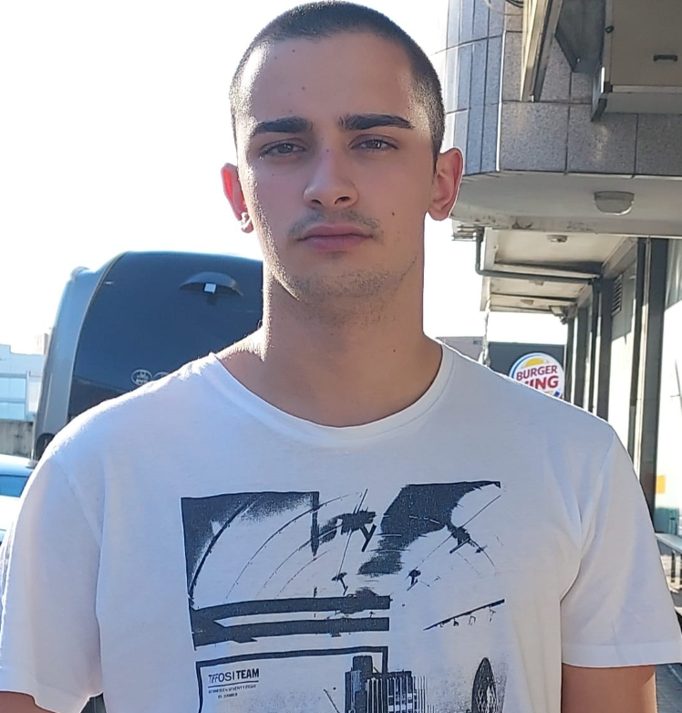
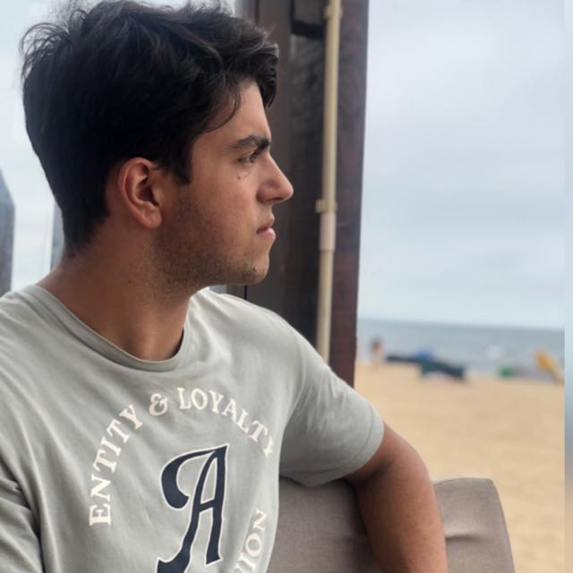
MEMBERS
1201416 – Pedro Alves
1211201 – Henrique Pinto
1201205 – Samuel Dias
1211136 – Bruna Costa

Slide 3
Summary
01
02
Introduction
Objectives
03
04
05
Planning
Teamwork
Difficulties

Slide 4

Summary
06
07
Products
Results
08
Conclusion

Slide 5
01.
Introduction

Slide 6
Group 8
This presentation aims to explain and demonstrate the work carried out by the team in the integrative project. During this presentation, the work methodologies, the development of the tasks, as well as the results obtained will be presented.

Slide 7
02.
Objectives

Slide 8
Main Goal
We aim to develop a new remote learning platform called “eCourse” using a minimum viable product (MVP) strategy. The company has allocated a three-month timeframe for this MVP project.

Slide 9
Objectives
Manage Users
Courses
Classes
Exams
Shared Boards
Meetings

Slide 10
03.
Planning

Slide 11
Planning
US | 17-23 april | 24-30 april | 2-7 may | 8-14 may | 15-21 may
1001
1002
1003
1004
1005
1006
1008
1010
2001
2002
2003
3001
3002
3003
18-26
18-30
30-06
30-08
08-18
26-30
30-06
07-13
10-21
16-19
16-19
11-13
29-04
16-19

Slide 12
Activities
ID | Description | Reponsable | Base Line | Real | Estado
1001 | As Manager, I want to be able to register, disable/enable, and list users of the system | Samuel Dias (1201205) | Start: 18-04-2023 End: 26-04-2023 | Start: 19-04-2023 End: 26-04-2023
1002 | As Manager, I want to create courses | Pedro Alves (1201416) | Start: 18-04-2023 End: 30-04-2023 | Start: 18-04-2023 End: 27-04-2023
1003 | As Manager, I want to open and close enrollements in courses | Pedro Alves (1201416) | Start: 30-04-2023 End: 06-05-2023 | Start: 27-04-2023 End: 06-05-2023

Slide 13
Activities
ID | Description | Reponsable | Base Line | Real | Estado
1004 | As Manager, I want to open and close courses | Pedro Alves (1201416) | Start: 30-04-2023 End: 08-05-2023 | Start: 27-04-2023 End: 07-05-2023
1005 | As Manager, I want to set the teachers of a course | Pedro Alves (1201416) | Start: 08-05-2023 End: 18-05-2023 | Start: 08-05-2023 End: 18-05-2023
1006 | As User, I want to list all the courses that are available to me | Henrique Pinto (1211201) | Start: 26-04-2023 End: 30-04-2023 | Start: 26-04-2023 End: 27-04-2023

Slide 14
Activities
ID | Description | Reponsable | Base Line | Real | Estado
1008 | As Student, I want to request my enrollment in a course | Henrique Pinto (1211201) | Start: 30-04-2023 End: 06-05-2023 | Start: 27-04-2023 End: 05-05-2023
1009 | As Manager, I want to approve or reject students applications to courses | Henrique Pinto (1211201) | Start: 07-05-2023 End: 14-05-2023 | Start: 06-05-2023 End: 12-05-2023
1010 | As Teacher, I want to schedule a class | Bruna Costa (1211136) | Start: 07-05-2023 End: 13-05-2023 | Start: 27-04-2023 End: 13-05-2023

Slide 15
Activities
ID | Description | Reponsable | Base Line | Real | Estado
2001 | As Teacher, I want to create/update an exam | All Team | Start: 10-05-2023 End: 21-05-2023 | Start: 10-05-2023 End: 21-05-2023
2002 | As Student, I want to view a list of my future exams | Bruna Costa (1211136) | Start: 16-05-2023 End: 19-05-2023 | Start: 16-05-2023 End: 19-05-2023
2003 | As Teacher, I want to view a list of all exams in a course | Bruna Costa (1211136) | Start: 16-05-2023 End: 19-05-2023 | Start: 16-05-2023 End: 19-05-2023

Slide 16
Activities
ID | Description | Reponsable | Base Line | Real | Estado
3001 | Communication infrastruture for the Shared Boards and the depoyment of the solution | All Team | Start: 11-05-2023 End: 13-05-2023 | Start: 11-05-2023 End: 12-05-2023
3002 | As User, I want to create a board | Samuel Dias (1201205) | Start: 29-04-2023 End: 04-05-2023 | Start: 29-04-2023 End: 04-05-2023
3003 | Shyncronization of shared boards and design a conceptual solution based on practical evidence. | All Team | Start: 16-05-2023 End: 19-05-2023 | Start: 17-05-2023 End: 17-05-2023

Slide 17
04.
Teamwork

Slide 18
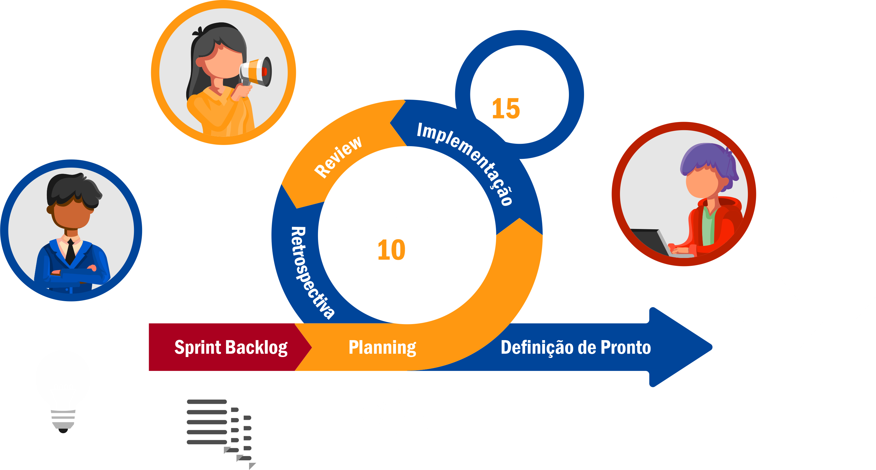
Teamwork Methodology

Slide 19



Conflict Resolution
Don’t Ignore Conflict
Bring Involved Parties Together to Talk
Solution

Slide 20
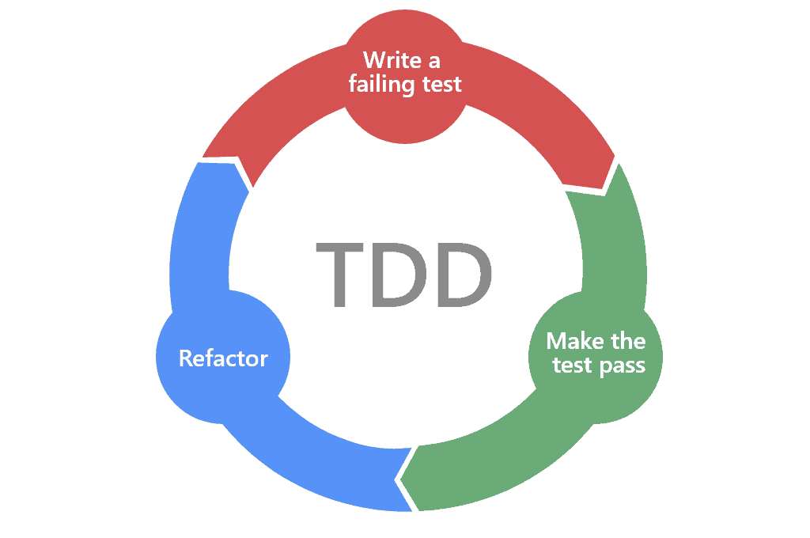
Development Process

Slide 21
05.
Difficulties

Slide 22


Difficulties

Slide 23
06.
Products

Slide 24




Products
Manager APP
Teacher APP
Student APP
SharedBoard APP

Slide 25
07.
Results
You can enter a subtitle here if you need it

Slide 26
Results
The team has developed what is necessary for the individual operation of each of the applications. ISEP hosting services were also used to carry out tests in production.

Slide 27
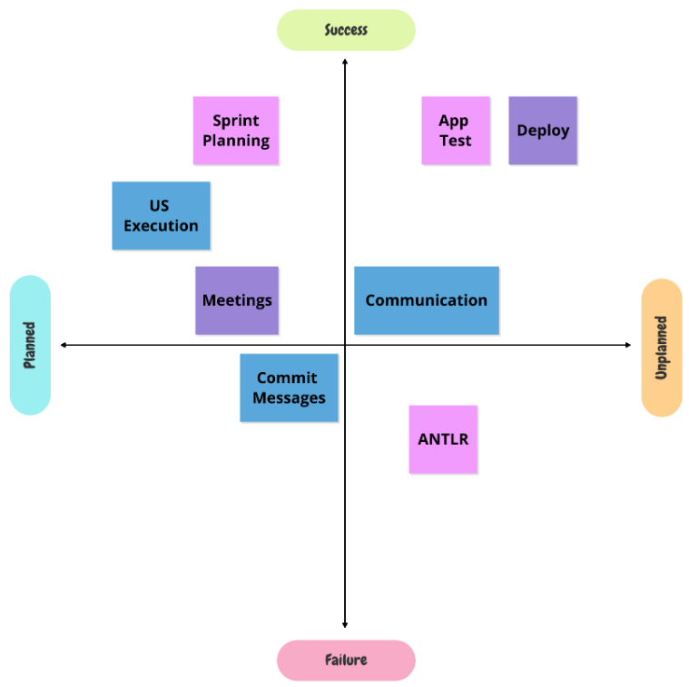

Slide 28
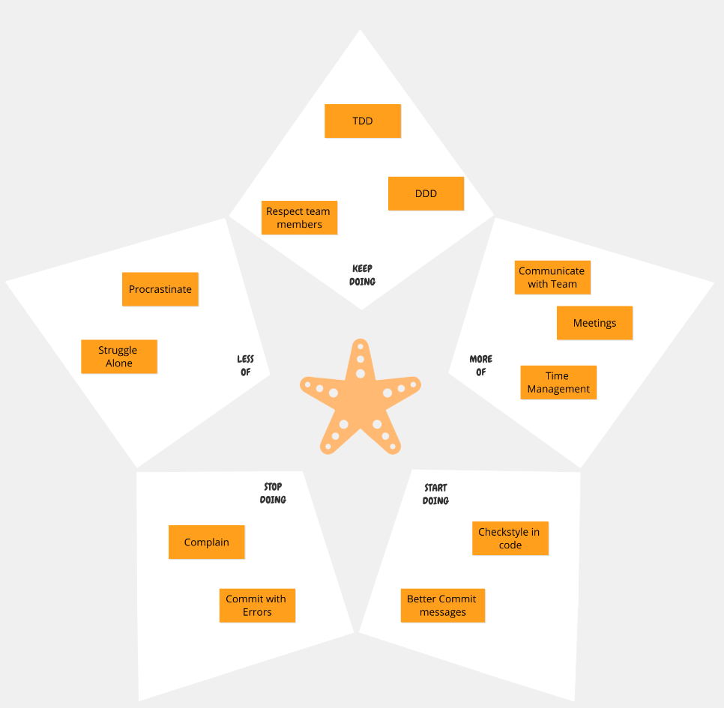

Slide 29
Conclusion!
The project met the group's expectations, it manages to improve our qualities as future engineers.
During the realization of this project, we managed to learn new ways of adapting to each other. Mainly manage the conflicts of the different personalities of the group members.
Now that we are at the end of the sprint, we can reflect and improve some of our strategies for the future.

